Slide 2
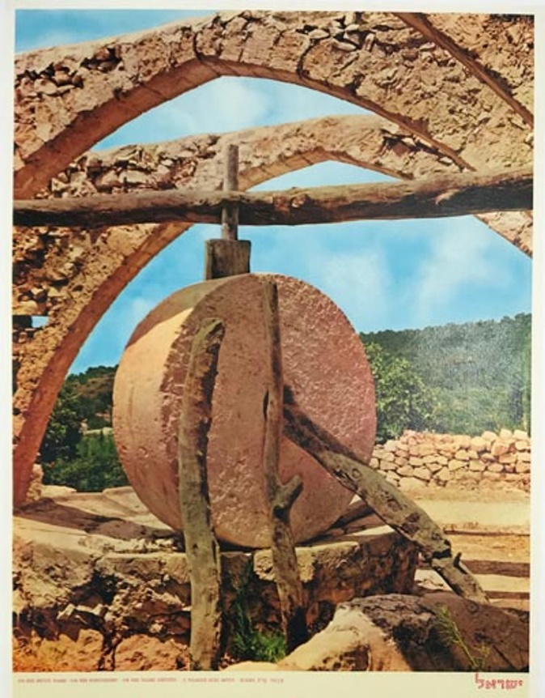
MILLSTONES

Slide 3
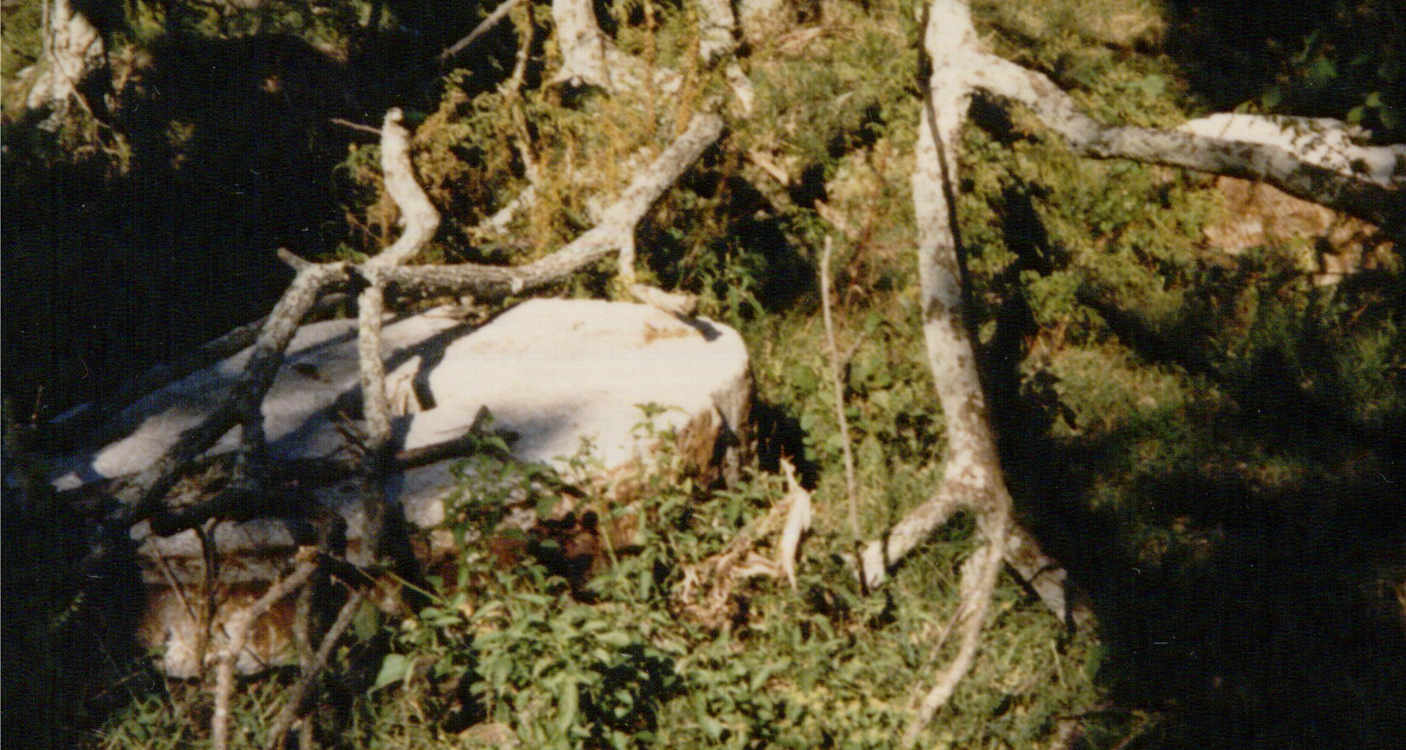
MILLSTONES
1. Necessities
2. They were Hard
3. They were Heavy

Slide 4
THE MILLSTONE NOT TO BE TAKEN IN PLEDGE
Deuteronomy 24:6 “No man shall take the lower or the upper millstone in pledge, for he takes one's living in pledge.”
Deuteronomy 23:19,20 – No interest to a brother
Every 50 years was a year of Jubilee – benefit the poor and relieve burdens
Exodus 22:26,27 – Garment in pledge
Galatians 5:14 "You shall love your neighbor as yourself." Exodus 22:27 “God is gracious”

Slide 5
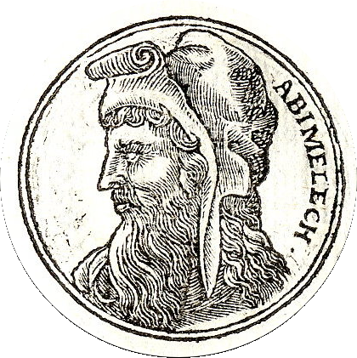
THE MILLSTONE USED TO DESCRIBE JOTHAM’S CURSE AS FULFILLED
Judges 9:53 – a son of Gideon
  Unprincipled & Ambitious Ruler
  Was Mortally Wounded During Siege of Thebaz
  Woman dropped upper millstone on his head and crushed his skull
Judges 9:56 – Judgment From God
  Retribution for killing his seventy brothers

Slide 6
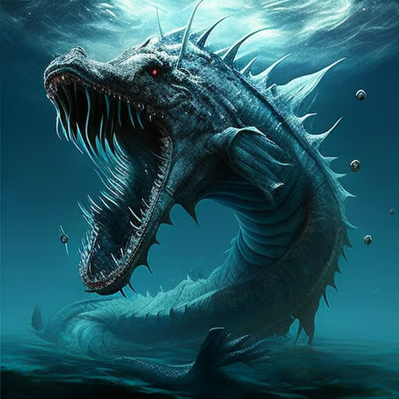
THE MILLSTONE IS LIKENED TO A HARD HEART IN JOB 41
Lord told Job about Leviathan!
V.9 “any hope of overcoming him is false;”
V.24 “His heart is as hard as stone, Even as hard as the lower millstone.”
Untouched by Sentiment and Righteousness Exodus 9:35
Christians must not have hard hearts – Ephesians 4:18; Hebrews 3:8,10; Psalm 95:7-11; Matthew 5:8

Slide 7
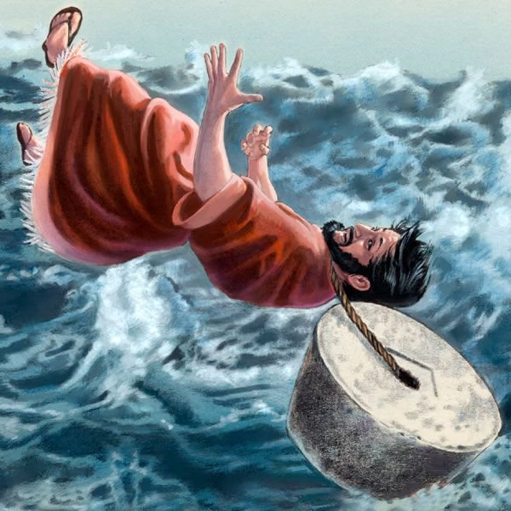
JESUS USED WEIGHT OF MILLSTONE TO MAKE A POINT ABOUT GOD’S RESPONSE TO SIN OF OFFENSE
Romans executed people by drowning them (katapontismos)
Victim would have no grave/burial
Point recorded in Matthew 18, Mark 9, and Luke 17
NKJV Matthew 18 “sin”; Mark uses “to stumble”; Luke uses the word “offenses.”
“σκανδαλ ζω skandalizō; to entrap, i.e. trip up (figuratively, stumble (transitively) or entice to sin, apostasy or displeasure): — (make to) offend.”

Slide 8
JESUS USED WEIGHT OF MILLSTONE TO MAKE A POINT ABOUT GOD’S RESPONSE TO SIN OF OFFENSE
“In NT skandalon is always used metaphorically, and ordinarily of anything that arouses prejudice, or becomes a hindrance to others, or causes them to fall by the way. Sometimes the hindrance is in itself good, and those stumbled by it are the wicked.” W.E. Vine
NOT talking about “hurting your feelings!”
“one of the little ones” – Not children but “the little ones who BELIEVE.”

Slide 9
JESUS USED WEIGHT OF MILLSTONE TO MAKE A POINT ABOUT GOD’S RESPONSE TO SIN OF OFFENSE
Christ did not advocate such tragic punishment- “it would be better” - hypothetical
Romans 14:13 “resolve this, not to put a stumbling block or a cause to fall in our brother’s way.”
1 Peter 4:8 “have fervent love for one another”
Acts 17:30 “now commands all men everywhere to repent,”

Slide 10
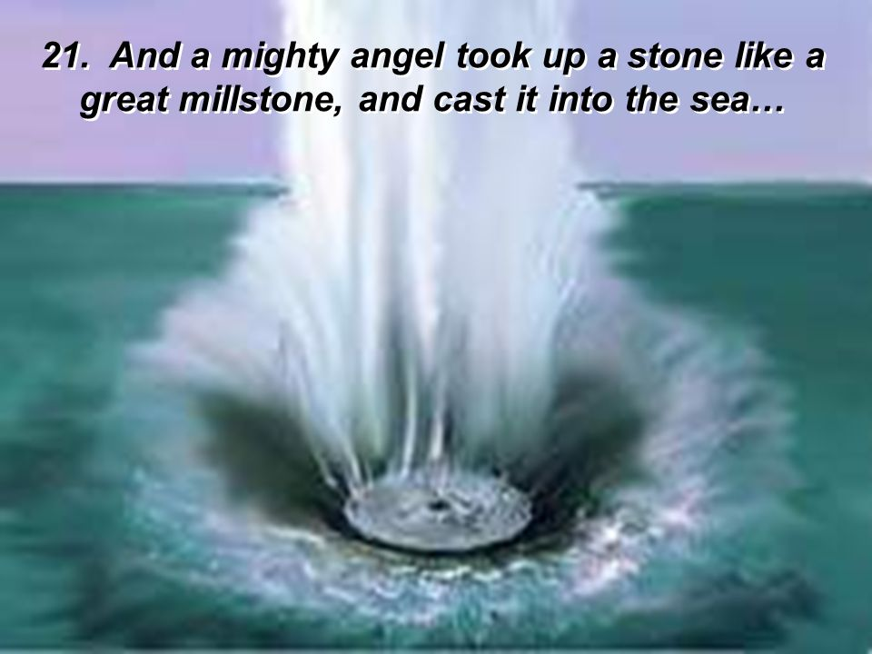
Fall Of Babylon Signified By Millstone Thrown Into Sea
Revelation 18:21,22
Babylon is the subject here – as in Jeremiah 51:61-64
Roman Empire is the one targeted in Revelation
God’s power brought about the downfall of Roman persecution (Revelation 18:21-23)

